Slide 1

OLSRv2 Simulation for MANET
First report presentation

Slide 2
Agenda
Project Description
The first report
Optimized Link State Routing Protocol Ver. 2
Main modules
Fields of expansion
Schedule
Questions and open discussion

Slide 3
Project Description
Simulating MANET environment implementing OLSRv2 protocol
Event Driven Simulator
Special interest in different Topology layouts
Output:
Network’s throughput
Average of hops per data packet

Slide 4
Main Goals
Utilization Analysis
Comparison between OLSR and naïve approach.
We will expect to see major improvement in the throughput when working in OLSR mode.

Slide 5
Main Goals
Topology
Comparison between different topology layouts. Specifically between uniform scatter and nodes clusters
Uniform scatter
Clusters

Slide 6
Main Goals
Scalability
Observation into the performance of the protocol when inducing large number of nodes.
Reliability
Is the protocol reliable? How many data messages don’t reach their destination due to protocol failure.

Slide 7
Project Description
Project Output:
Throughput comparison between number of different Topology layouts
Throughput comparison between different MPR sets selection (minimal Vs maximal)
Scalability
Network reliability

Slide 8
The First Report
Introduction
NHDP
OLSRv2
Project Description
Goals
Output
General Layout

Slide 9
The First Report
Main Modules
Main Algorithms
Event generation and manipulation
Throughput Analysis
Appendixes
Estimated project timetable
Requirements
Screens shots

Slide 10
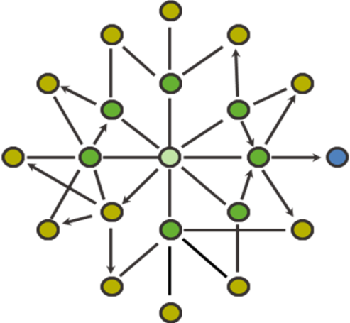
Optimized Link Status Protocol
Based on 1-hop & 2-hop Neighbors sets
Multi Point Relay set

Slide 11
Optimized Link Status Protocol
MPR
Each node notifies its MPR set for their nomination
MPRs broadcast their new role
All nodes can now build a routing table
MPR
Target
MPR
MPR
MPR
Source
MPR

Slide 12
Main Modules
Log
GUI
GUI
Log
OLSR Nodes
Event Gen
Topology Mgr
Tasks Queue
Dispatcher
Tasks Queue
OLSRv2 Layer
(per node)
Event Generator
Dispatcher
Topology Manager

Slide 13
Fields of Expansion
Topology Mobility
Secondary MPR sets
Connection quality (Topology constrains)

Slide 14
Schedule
18.11.2009 – First Report Submission
25.11.2009 – First Report Feedback
30.12.2009 – Project Review
15.1.2010 - Project Presentation and Final Report Submission

Slide 15
Questions
&
Open Discussion

Slide 16
Thank you !
Assaf Israel
Eli Nazarov
Asi Bross

